Slide 1

Market Basket Analysis
March 19, 2021
Anupama r.k, Queenie Tsang, Crystal (Yunan) Zhu

Slide 2
Business case
Notes:
reduces a customer’s shopping time,
reminds the customer of what relevant items (s)he might be interested in buying,
helping stores cross-sell in the process

Slide 3
structure of original dataset

Slide 5
Notes:
People mostly order from 8:00 - 17:00 (8AM - 5PM)

Slide 7
Notes:
p2 <- X %>%
group_by(user_id, product_id) %>%
dplyr::summarise(count3=n()) %>%
select(user_id, product_id, count3) %>%
ungroup() %>%
group_by(user_id) %>%
dplyr::summarise(count_product=n()) %>%
ungroup()

Slide 8
Count of Products sold by department

Slide 9
When are orders placed (Day of week)?

Slide 10
transactions by days since prior order

Slide 13
Data Preparation for Association RULE

Slide 14
Transaction data in Transaction format
Notes:
all the items within a transaction are in the same row

Slide 15
Association rule
List of items with the same order ID are studied as a group – user information will not be taken into consideration.
Metrics to measure the strength of the rules
Support: how frequent an itemset is in all the transactions – value we use: 0.0015 (the itemset should occur in at least 0.15% of all transactions)
Confidence: the likeliness of occurrence of consequent on the cart given that the cart already has the antecedents – value we use: 0.4
Note: The confidence for an association rule having a very frequent consequent will always be high
Lift: the rise of the confidence that {X} provides to us for having {Y} on the cart (whether X increases the chance of buying Y).
Lift is the measure that will help store managers to decide product placements on aisle.
Notes:
Apriori - All subsets of a frequent itemset must also be frequent - if we drop out an item from an itemset, support value of new itemset generated will either be the same or will increase.
Apriori principle allows us to prune all the supersets of an itemset which does not satisfy the minimum threshold condition for support. For example, if {Milk, Notebook} does not satisfy our threshold of minsup, an itemset with any item added to this will never cross the threshold too.
Pruning of infrequent itemsets could reduce the number of itemsets to be considered by more than half!

Slide 16
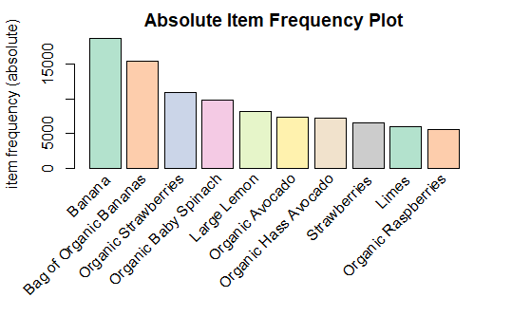
Association rule
In total,131,209 unique orders and 39,123 unique product names
We chose the top 50 products to mine the rules
Less frequently bought items have less chance of appearing in any rules
Less frequently bought items will not affect the rules much

Slide 17
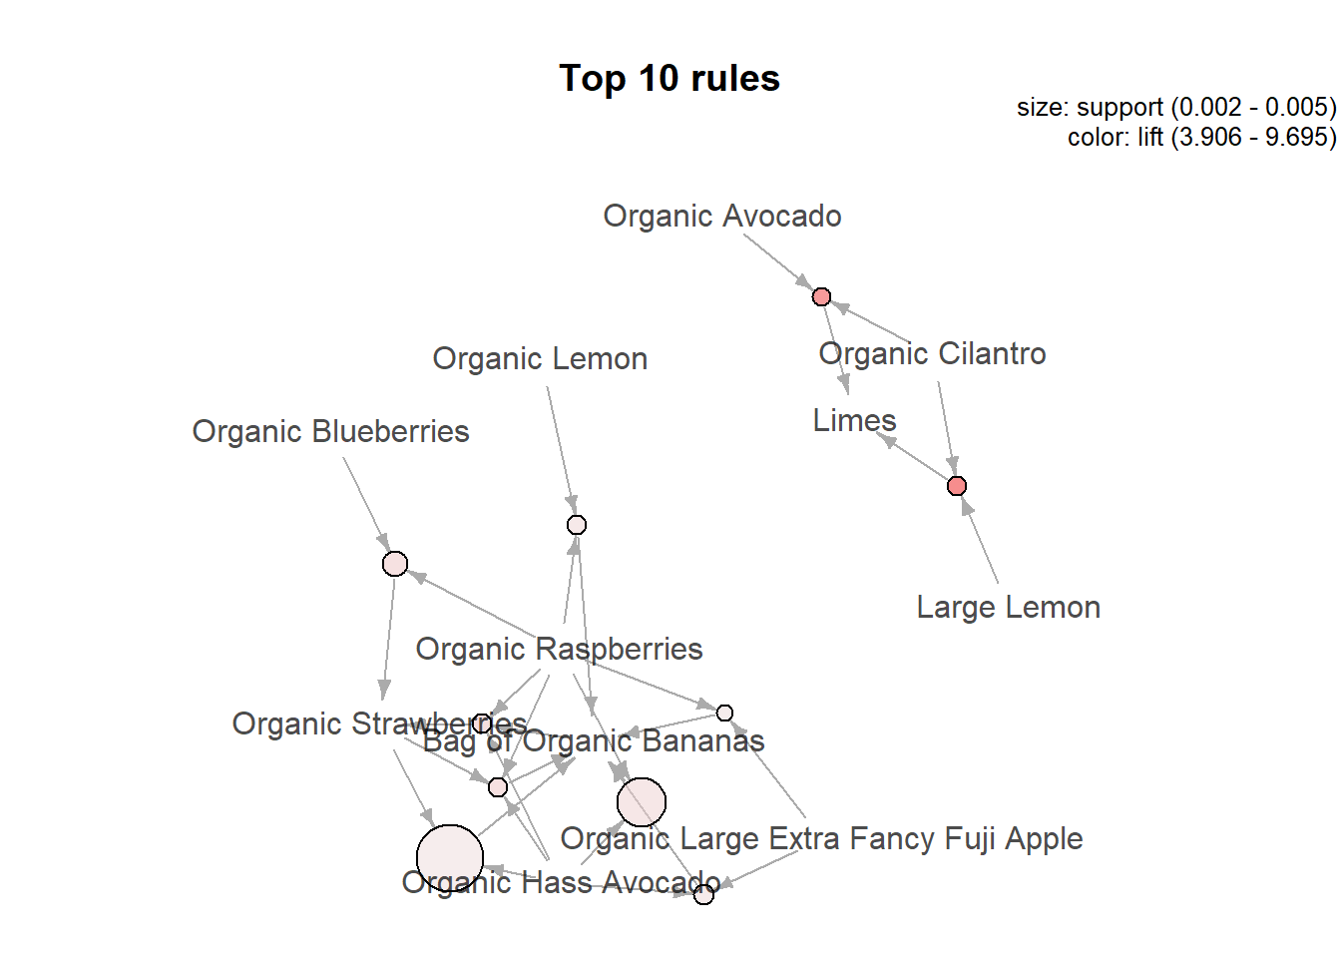
Mined rules
Sample rules
lhs |  | rhs | support | confidence | lift
{Broccoli Crown, Organic Avocado} | => | {Banana} | 0.0015 | 0.419 | 2.935
{Organic Lemon, Organic Raspberries} | => | {Bag of Organic Bananas} | 0.0017 | 0.499 | 4.229

Slide 18
Weighted Alternating Least Squares with Implicit Feedback Data (WALSIFD)
To identify products that has a high probability of being clicked on or purchased by a user, based on their previous transactions.

Slide 19
RecommenderLab FOr evaluation of different Recommender Systems
compare common algorithms typically used to create recommendery systems.
2 types of rating matrix for modelling is available
we will be using the binary rating matrix type where 0 indicates product is not purchased, while 1 indicates product is purchased.
Notes:
Binary rating matrix is useful when no actual user ratings is available, and it also does not require normalisation.
The rating matrix must be rearranged with orders in rows and products in columns.

Slide 20
Evaluation scheme and Model validation
Evaluate the model’s effectiveness using recommenderlab’s evaluation schemes.
Split the data into a training set and test set with train taking 80% of the data and test taking 20% of the
data.
Set method=“cross” and k=5 for 5 fold cross-validation. Data will be split into k subsets of equal size, and
80% of data will be used for training and last 20% for evaluation. Models are then estimated recursively
5 times, and a different train/test split is used each time.
Results are then averaged to produce a single evaluation set

Slide 21
Set up a list of algorithms
Create a list of algorithms from recommenderlab and specify model parameters. Pass the scheme and algorithms to the evaluate() function, to evaluate several recommender algorithms using an evaluation scheme. The end product is a evaluation result list.
v
Notes:
Consider schemes which
evaluate on the binary rating matrix and include random items algorithm for benchmarking
elect type= topNList to evaluate a Top N List of product recommendations and specify how many recom_x0002_mendations to calculate with the parameter n = c(1,3,5,10,15,20)

